Slide 1
Corona Virus Analysis
Mentorness Internship Project
Name: Mozadded-Ul-Islam

Slide 2
Table of contents
01
02
03
04
Project Overview
Dataset Description
Analysis (Queries)
Summary

Slide 3
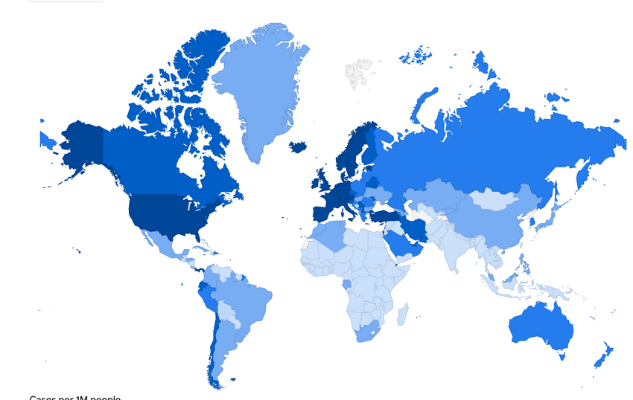
01 Project Overview
Corona Virus has an extreme impact on public health all around the world during 2020 and 2021 and has created an urgent need for data-driven insights to understand the spread of the virus.
As a Data Analyst, I analysed the dataset to derive meaningful insights and here I am presenting my findings.
Application Used: Microsoft SQL Server Management Studio 2022, Excel.
Language: SQL.

Slide 4
02 Dataset Description
Column Name | Description
Province | Geographic subdivision within a country/region.
Country_Region | Geographic entity where data is recorded.
Latitude | North-south position on Earth's surface.
Longitude | East-west position on Earth's surface.
Date | Recorded date of Corona Virus data.
Confirmed | Number of diagnosed Corona Virus cases.
Deaths | Number of Corona Virus related deaths.
Recovered | Number of recovered Corona Virus cases.

Slide 5
03 Analysis (Queries)
Write a code to check NULL values.
select * from dataset.dbo.coronavirusdataset
where Province is null or Country_Region is null or
Latitude is null or Longitude is null or
Date is null or Confirmed is null or
Deaths is null or Recovered is null
If NULL values are present, update them with zeros for all columns.
Select * from dataset.dbo.coronavirusdataset
Update dataset.dbo.coronavirusdataset
SET
Province = Coalesce(Province, '0'),
Country_Region = Coalesce(Country_Region, '0'),
Latitude = Coalesce(Latitude, '0'),
Longitude = Coalesce(Longitude, '0'),
Date = Coalesce(Date, '0'),
Confirmed = Coalesce(Confirmed, '0'),
Deaths = Coalesce(Deaths, '0'),
Recovered = Coalesce(Recovered, '0');
Check total number of rows
Select COUNT(*) as totalRows from dataset.dbo.coronavirusdataset
78,386

Slide 6
03 Analysis (Queries)
Check what is start_date and end_date.
select
MIN(TRY_CONVERT(date, Date, 103)) as startDate,
MAX(TRY_CONVERT(date, Date, 103)) as endDate
from dataset.dbo.coronavirusdataset
22-01-2020 & 13-06-2021
Number of month present in dataset.
select
COUNT(DISTINCT CONCAT(YEAR(TRY_CONVERT(date, Date, 105)), '-',
MONTH(TRY_CONVERT(date, Date, 105))))
AS numberOfMonths
from dataset.dbo.coronavirusdataset
18 months.

Slide 7
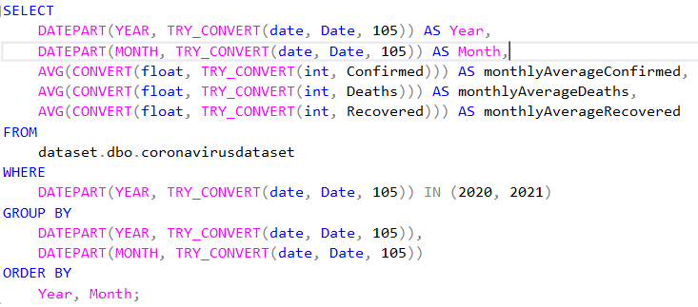
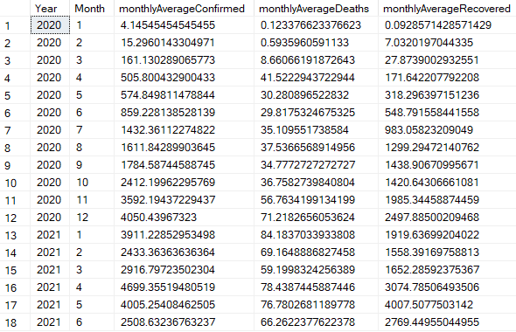
03 Analysis (Queries)
Find monthly average for confirmed, deaths, recovered

Slide 8
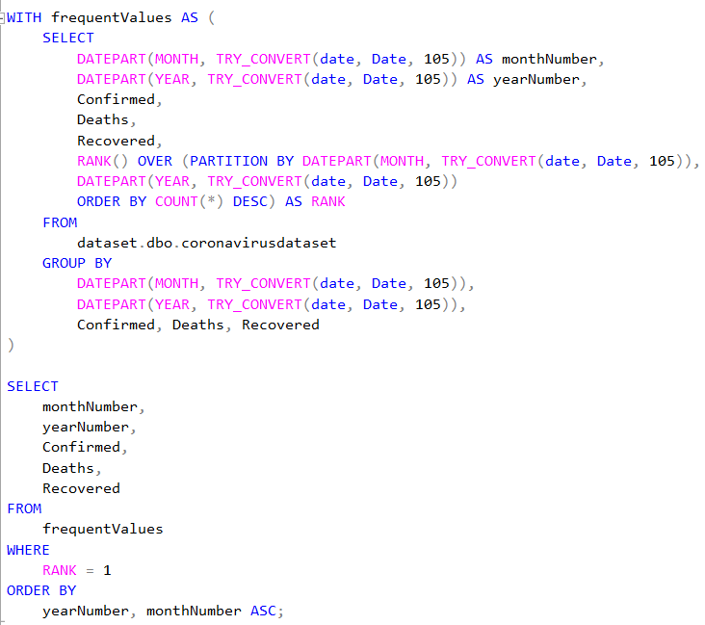
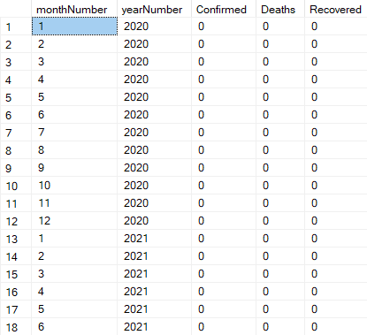
03 Analysis (Queries)
Find most frequent value for confirmed, deaths, recovered each month

Slide 9
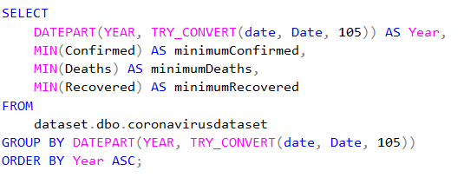
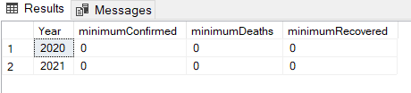
03 Analysis (Queries)
Find monthly average for confirmed, deaths, recovered

Slide 10
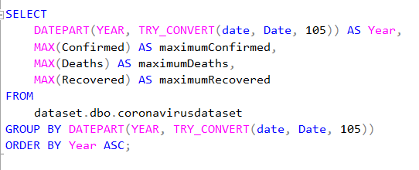
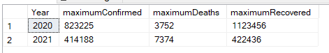
03 Analysis (Queries)
Find maximum values of confirmed, deaths, recovered per year

Slide 11
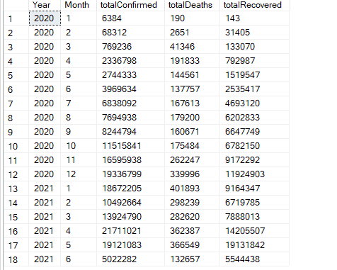
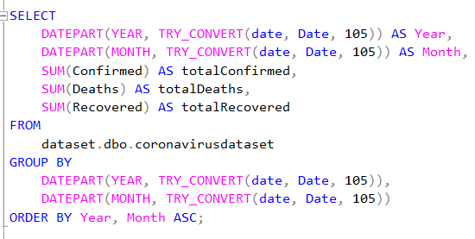
03 Analysis (Queries)
The total number of case of confirmed, deaths, recovered each month

Slide 12
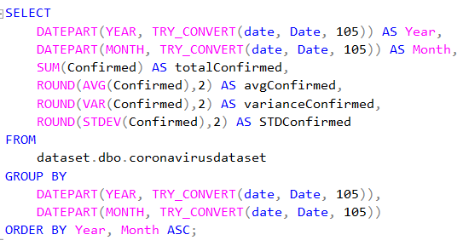
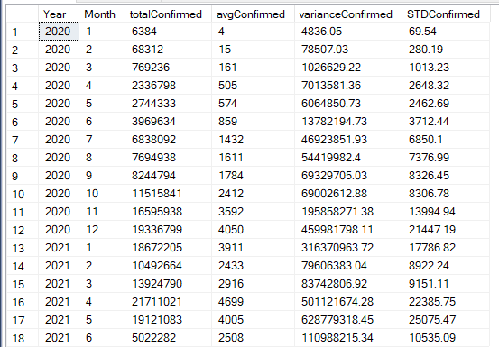
03 Analysis (Queries)
Check how corona virus spread out with respect to confirmed case

Slide 13
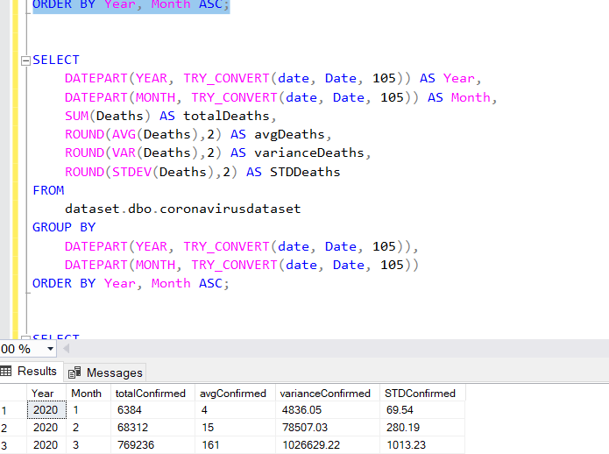
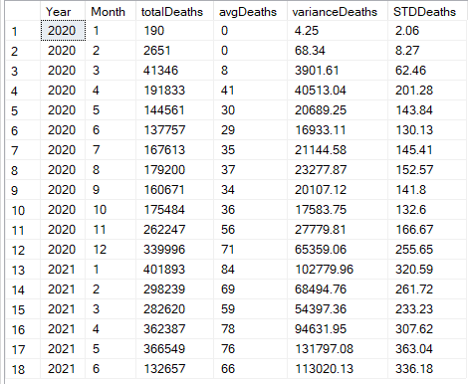
03 Analysis (Queries)
Check how corona virus spread out with respect to death case per month

Slide 14
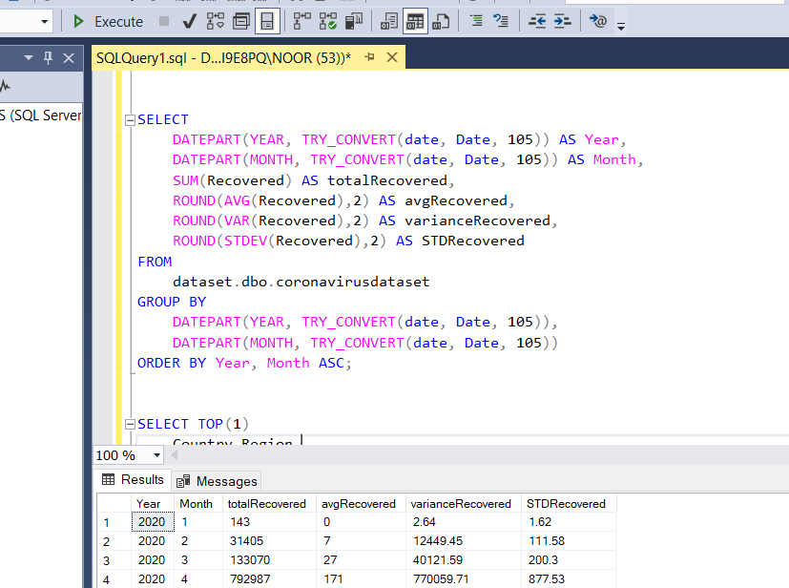
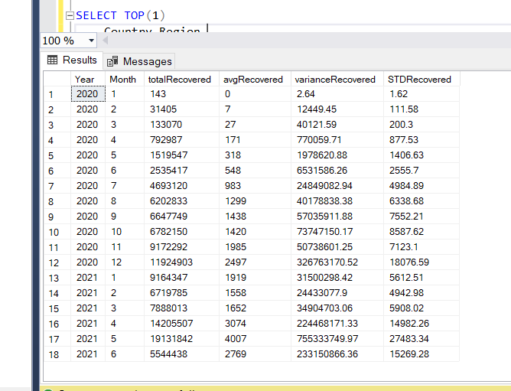
03 Analysis (Queries)
Check how corona virus spread out with respect to recovered case

Slide 15
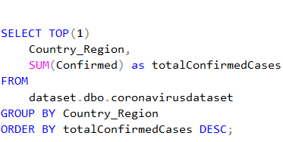
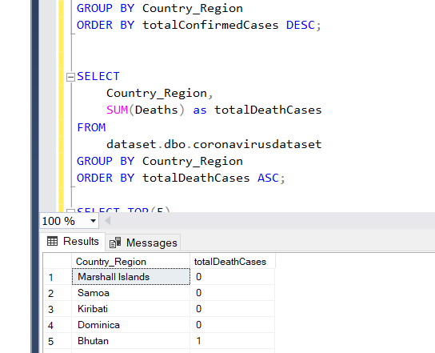
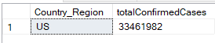
03 Analysis (Queries)
Find Country having highest number of the Confirmed case
Find Country having lowest number of the death case

Slide 16
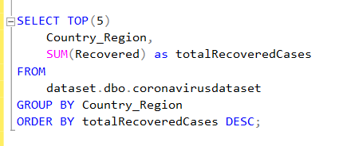
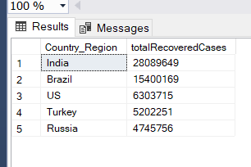
03 Analysis (Queries)
Find top 5 countries having highest recovered case

Slide 17
04 Summary
Total number of confirmed cases are 169,065,144.
Total number of deaths are 3,647,894, and recovered are 113,089,548.
The percentage of recovery is almost 66.9%~67%.
In terms of at least one death case, Bhutan has the least death case of only 1 from 1813 confirmed cases.
Marshall Island has 5, Samoa has 3, Kiribati has 2 and Dominica has 189 of confirmed cases but no record of deaths.
US has the most number of confirmed cases and deaths which are 33,461,982 and 599,769.
India has the most number of recovered cases, which are 28,089,649.

Slide 18
Thank You

